Slide 1

UKACM-SEMNI Autum School
Operator learning for
Partial Differential Equations
Dr Burigede Liu
University of Cambridge
Email: BL377@cam.ac.uk

Slide 2
Overview of lecture 1
Neural Network Basics
PDE basics
Solving PDE – classical methods and PINN
PDE in operator form
Solution operator for Linear PDEs
Approximating the Kernel function – Neural Operator motivation
Neural Operator architecture

Slide 3
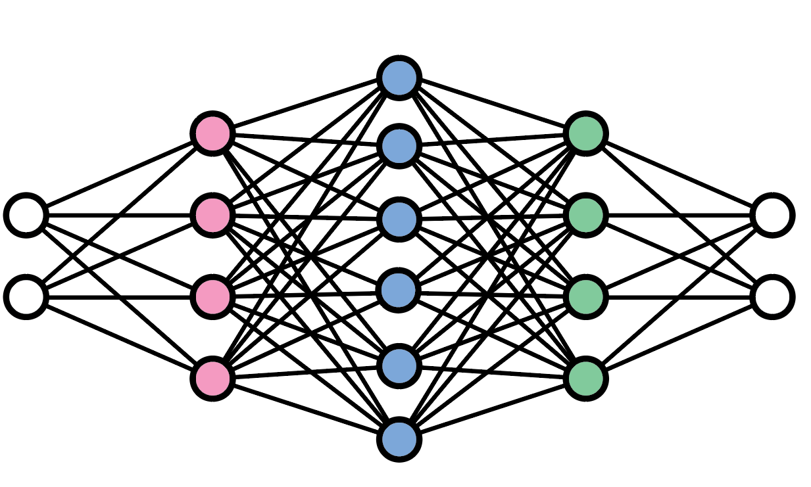
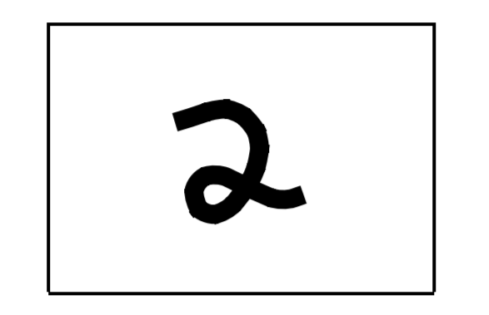
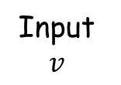
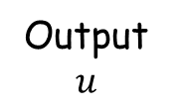
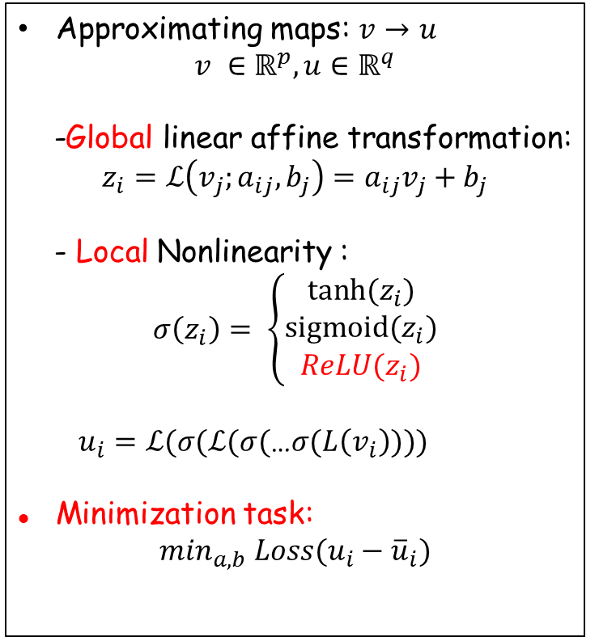
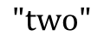
Neural network
Mathematical structure
Approximating maps: $v$ $→$ $u$
$$v ∈ℝ^{p}, u∈ℝ^{q}$$
-Global linear affine transformation:
$$z_{i}=ℒ\left(v_{j};a_{ij}, b_{j}\right)=a_{ij}v_{j}+b_{j}$$
- Local Nonlinearity :
$$σ\left(z_{i}\right)= \left\{\begin{aligned}tanh⁡(z_{i}) \\ sigmoid(z_{i}) \\ ReLU(z_{i})\end{aligned}\right.$$
$u_{i}=ℒ(σ(ℒ(σ($…$σ(L\left(v_{i}\right))))$
Minimization task:
$$\min_{a,b} Loss(u_{i}−{\overline{u}}_{i})$$
$$"two"$$
Input
$$v$$
Output
$$u$$
Hidden layers
Classical neural network architecture
This architecture is surprisingly expressive.

Slide 4
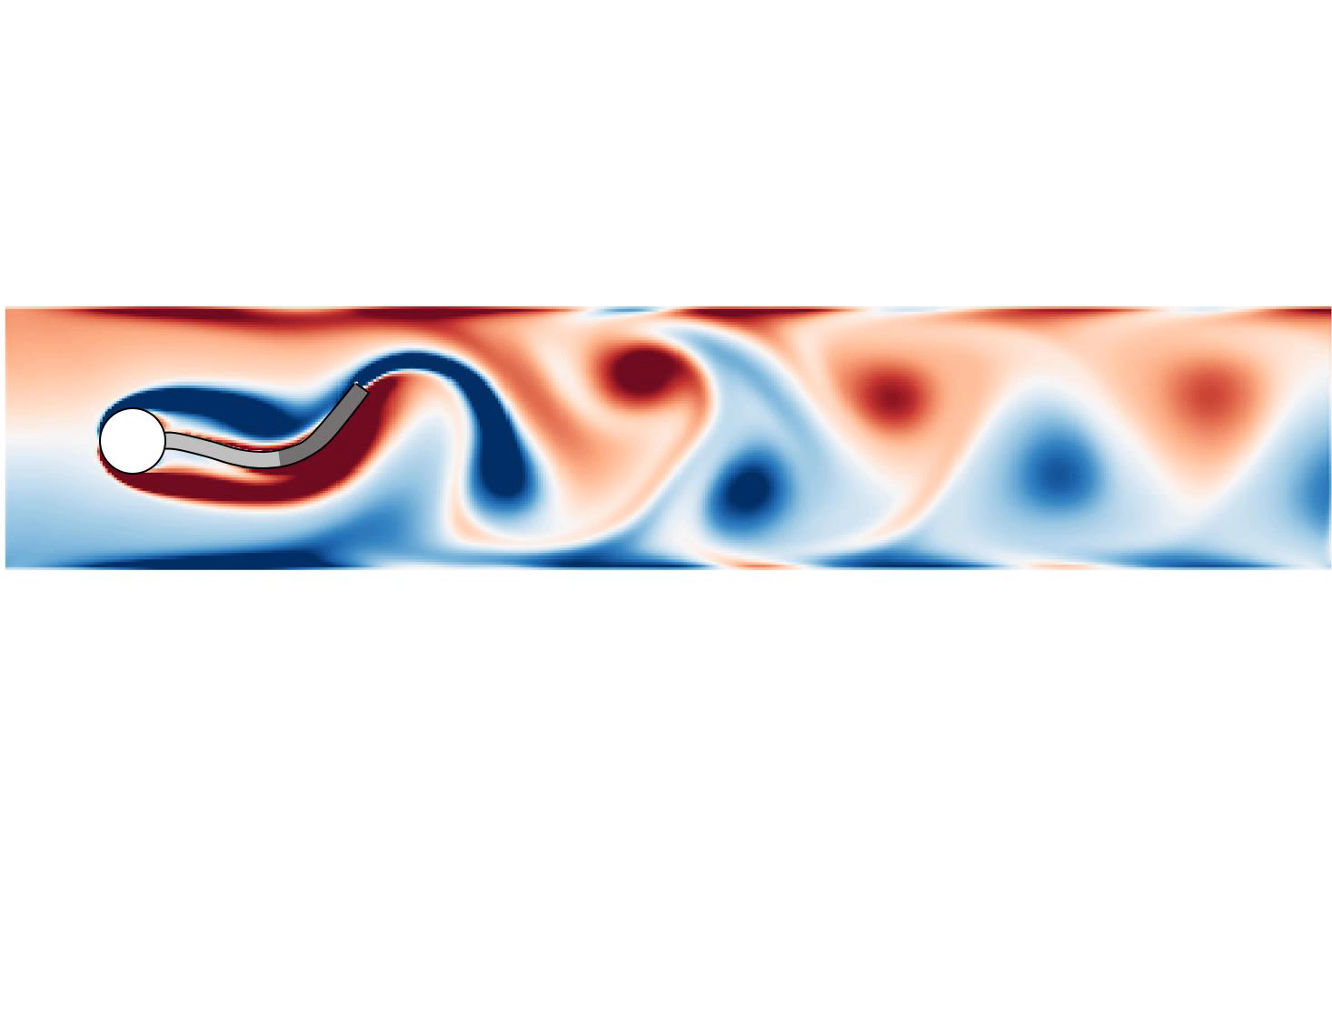
PDE as a foundation for scientific modeling
Fluid
Navier Stokes
$$ρ∂_{t}u+\left(u⋅∇\right)u=∇∙ℱ\left(∇u\right)+ρg$$

Slide 5
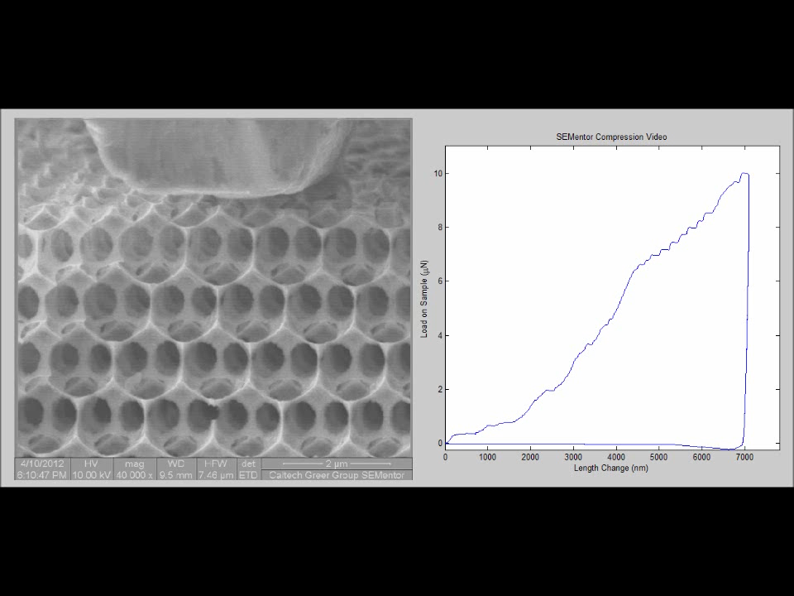
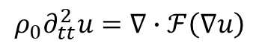
PDE as a foundation for scientific modeling
Solid
Nonlinear wave
$$ρ_{0}∂_{tt}^{2}u=∇∙ℱ\left(∇u\right)$$

Slide 6
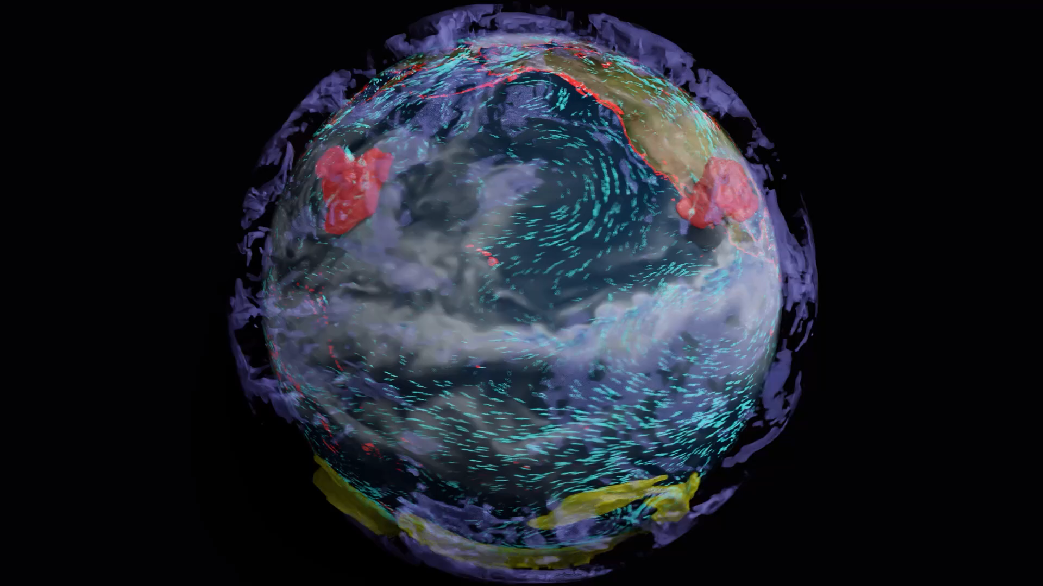
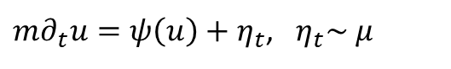
PDE as a foundation for scientific modeling
Climate Science
Stochastic Differential Equation (2021 Nobel Prize!)
$m∂_{t}u=ψ\left(u\right)+η_{t}$, $η_{t}\sim μ$
Hasselmann, Klaus. "Stochastic climate models part I. Theory." tellus 28.6 (1976): 473-485.

Slide 7
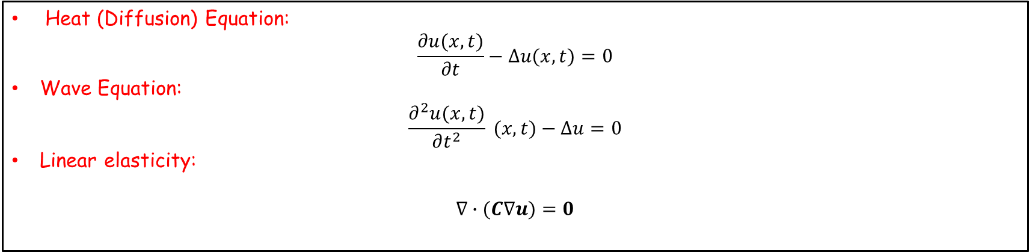
Basics of PDE
Partial Differential Equation (PDE)
An equation involving an unknown function of two or more variables and certain of its partial derivatives.
Examples – Linear PDE
Heat (Diffusion) Equation:
$$\frac{∂u(x,t)}{∂t}−∆u(x,t)=0$$
Wave Equation:
$$\frac{∂^{2}u(x,t)}{∂t^{2}} (x,t)−∆u=0$$
Linear elasticity:
$$∇∙(C∇u)=0$$
Definition: u and its partial derivatives only occur linearly, with coefficients that are functions of independent variables.

Slide 8
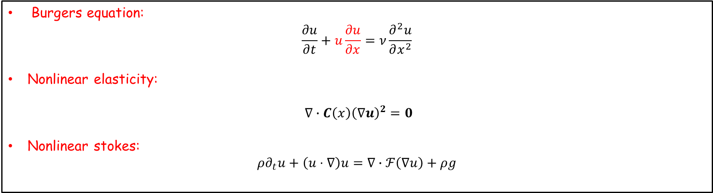
Basics of PDE
Partial Derivative Equation (PDE)
An equation involving an unknown function of two or more variables and certain of its partial derivatives.
Examples – Nonlinear PDE
Burgers equation:
$$\frac{∂u}{∂t}+u\frac{∂u}{∂x}=ν\frac{∂^{2}u}{∂x^{2}}$$
Nonlinear elasticity:
$∇∙C\left(x\right){\left(∇u\right)}^{2}=0$
Nonlinear stokes:
$$ρ∂_{t}u+\left(u⋅∇\right)u=∇∙ℱ\left(∇u\right)+ρg$$
Definition: PDE with nonlinear terms.

Slide 9

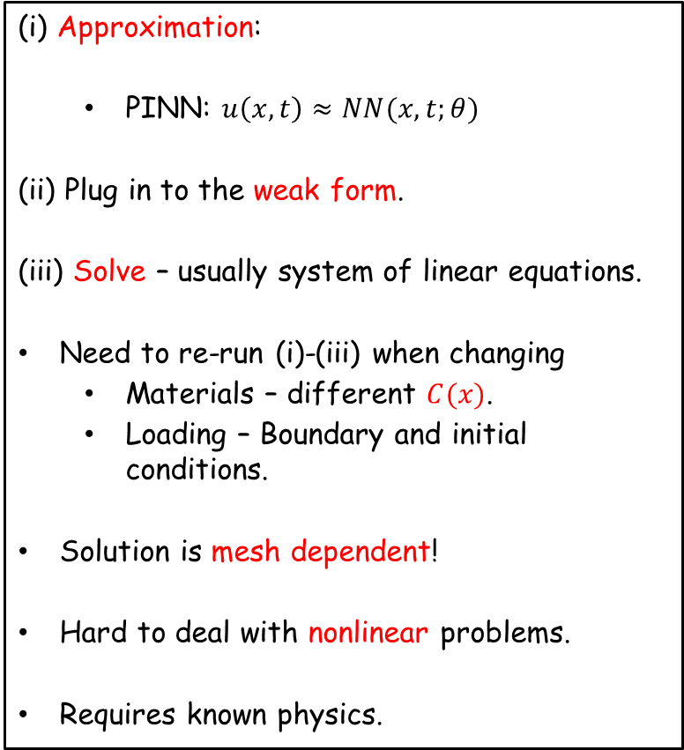

Conventional approach: solving PDEs
Example Linear elasticity
Solving a PDE
(i) Balance of linear momentum:
(ii) Constitutive model (closure):
(iii) Boundary condition:
(iv) Kinematics
(i) Approximation:
PINN: $u\left(x,t\right)≈NN(x,t;θ)$
(ii) Plug in to the weak form.
(iii) Solve – usually system of linear equations.
Need to re-run (i)-(iii) when changing
Materials – different $C(x)$.
Loading – Boundary and initial conditions.
Solution is mesh dependent!
Hard to deal with nonlinear problems.
Requires known physics.
$∇_{x}∙σ=0$ | $u∈Ω$
$$σ=C(x)⋅ε$$ | $u∈Ω$
$$σ∙n=h$$ $$u=g$$ | $u∈{∂Ω}_{u}$ $$u∈{∂Ω}_{σ}$$
$$ε=\frac{1}{2}(∇u+∇u^{T})$$ | $u∈Ω$

Slide 10
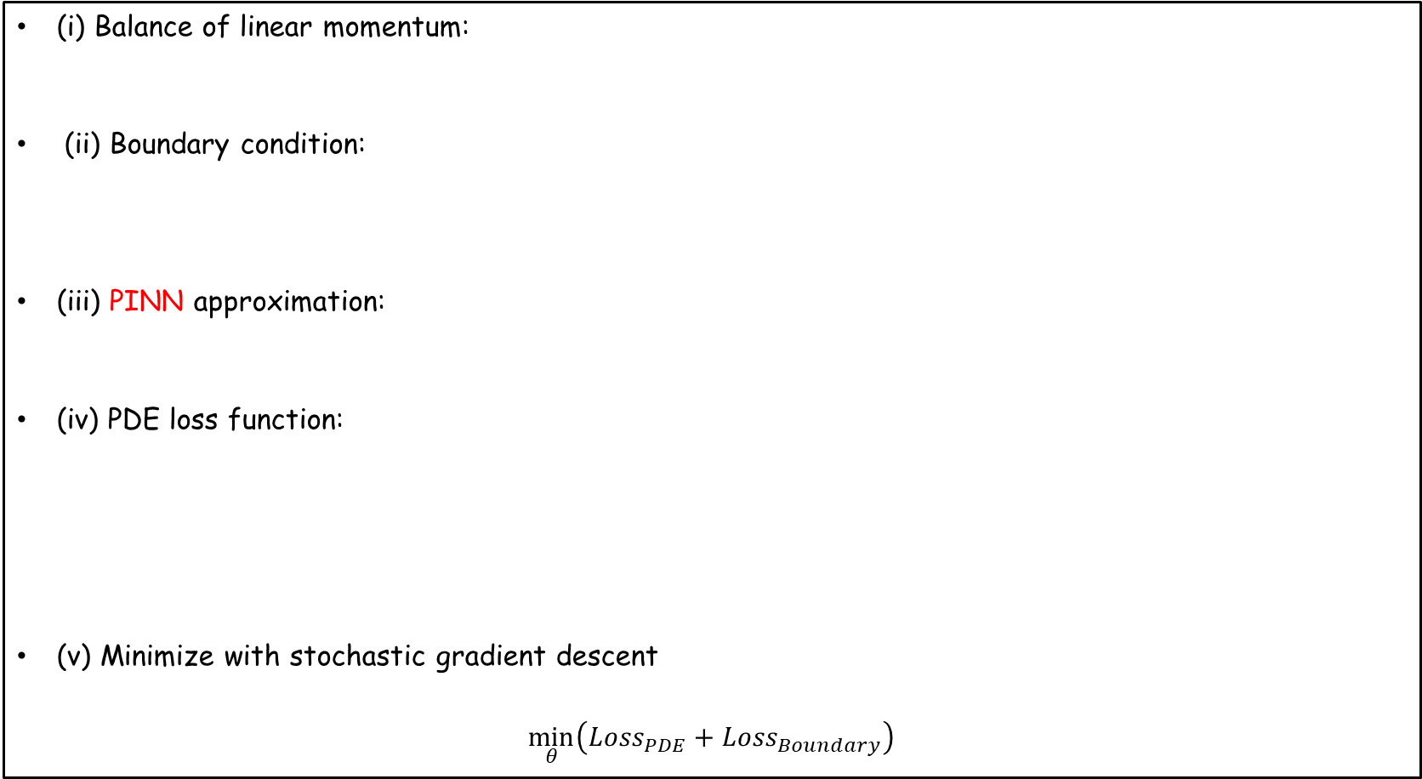

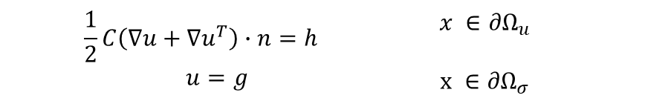
Conventional approach: Neural Network basis function
PINN
(i) Balance of linear momentum:
(ii) Boundary condition:
(iii) PINN approximation:
(iv) PDE loss function:
(v) Minimize with stochastic gradient descent
$\min_{θ}\left(Loss_{PDE}+Loss_{Boundary}\right)$
$∇_{x}∙(\frac{1}{2}C\left(∇u+∇u^{T}\right))=0$ | $x∈Ω$
$$\frac{1}{2}C\left(∇u+∇u^{T}\right)∙n=h$$ $$u=g$$ | $x ∈{∂Ω}_{u}$ $x ∈{∂Ω}_{σ}$
$u\left(x\right)≈u\left(x;θ\right)= NN(x;θ)$
$$Loss={\left|∇_{x}∙\left(\frac{1}{2}C\left(∇u\left(x;θ\right)+∇{u\left(x;θ\right)}^{T}\right)\right)\right|}_{2}+|\frac{1}{2}C\left(∇u\left(x;θ\right)+∇{u\left(x;θ\right)}^{T}\right)∙n−h {\left.​\right|}_{2}+{\left|u−g\right|}_{2}$$
PDE loss
Boundary loss

Slide 11
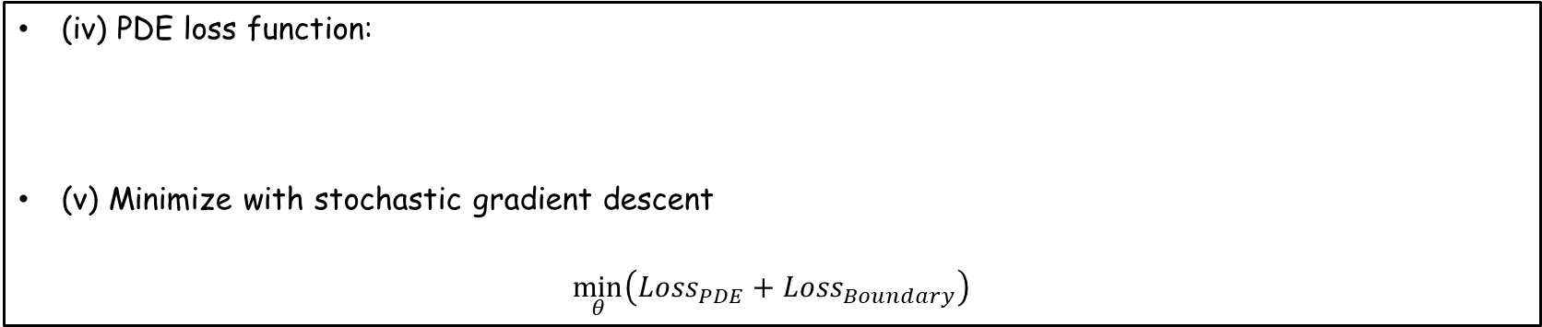
Conventional approach: Neural Network basis function
PINN
(iv) PDE loss function:
(v) Minimize with stochastic gradient descent
$\min_{θ}\left(Loss_{PDE}+Loss_{Boundary}\right)$
$$Loss={\left|∇_{x}∙\left(\frac{1}{2}C\left(∇u\left(x;θ\right)+∇{u\left(x;θ\right)}^{T}\right)\right)\right|}_{2}+|\frac{1}{2}C\left(∇u\left(x;θ\right)+∇{u\left(x;θ\right)}^{T}\right)∙n−h {\left.​\right|}_{2}+{\left|u−g\right|}_{2}$$
Challenges
Hard to get them to work (you need around 1e5 epochs for typical linear problems.
Requires huge collocation points and no guarantee of convergence.
Cannot show realistic speed-up compare against FEM.
But a developing field with a lot of interests due to its simplicity. (Deep Ritz, Galerkin PINN, etc. et…)

Slide 12
So, what else can we do?

Slide 13
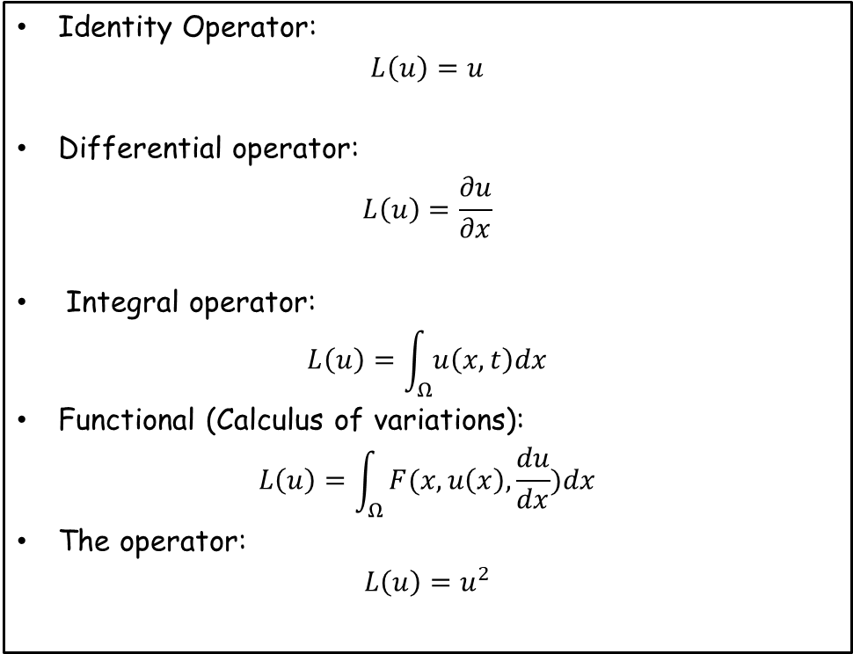
Operators
Operators
Example
A mapping that takes a function as input, and output a (likely different) function.
Identity Operator:
$$L\left(u\right)=u$$
Differential operator:
$$L\left(u\right)=\frac{∂u}{∂x}$$
Integral operator:
$$L\left(u\right)=\int_{Ω}{u\left(x,t\right)dx}$$
Functional (Calculus of variations):
$$L\left(u\right)=\int_{Ω}{F(x,u\left(x\right),\frac{du}{dx})dx}$$
The operator:
$$L\left(u\right)=u^{2}$$
Kovachki, Nikola, et al. "Neural operator: Learning maps between function spaces with applications to PDEs." Journal of Machine Learning Research 24.89 (2023): 1-97.

Slide 14
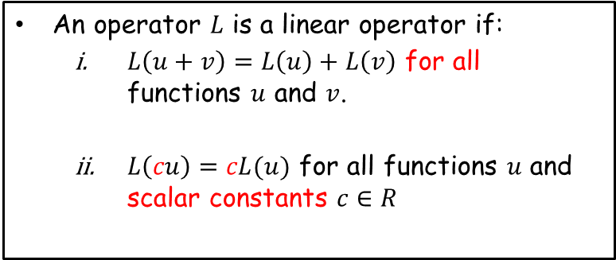
Operators
Operators
Example
A mapping that takes a function as input, and output a (likely different) function.
Identity Operator:
$$L\left(u\right)=u$$
Differential operator:
$$L\left(u\right)=\frac{∂u}{∂x}$$
Integral operator:
$$L\left(u\right)=\int_{Ω}{u\left(x,t\right)dx}$$
Functional (Calculus of variations):
$$L\left(u\right)=\int_{Ω}{F(x,u\left(x\right),\frac{du}{dx})dx}$$
The operator:
$$L\left(u\right)=u^{2}$$
Linear Operators
An operator $L$ is a linear operator if:
$L\left(u+v\right)=L\left(u\right)+L\left(v\right)$ for all functions $u$ and $v$.
$L\left(cu\right)=cL(u)$ for all functions $u$ and scalar constants $c∈R$
Nonlinear Operators
If an operator is not linear, it is said to be nonlinear.

Slide 15
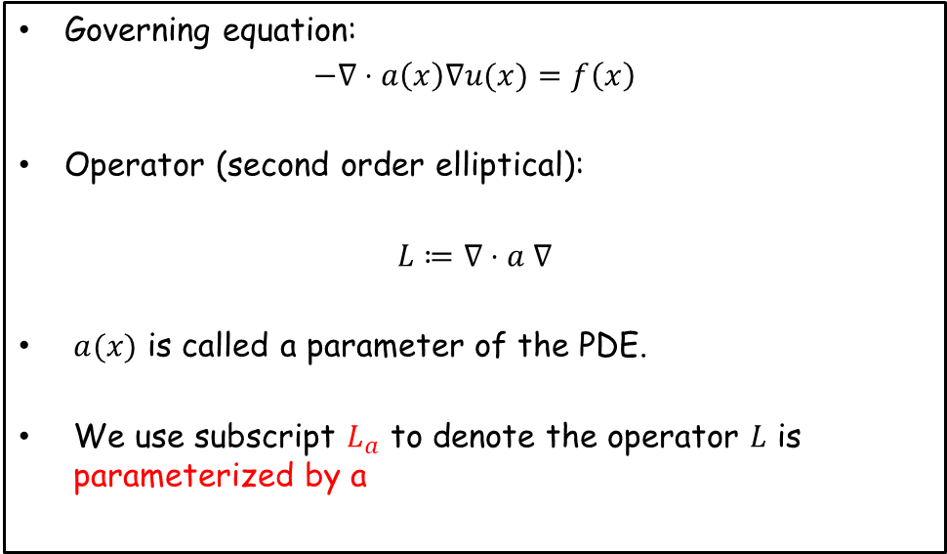
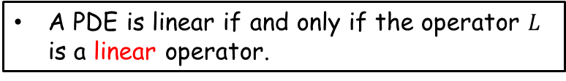
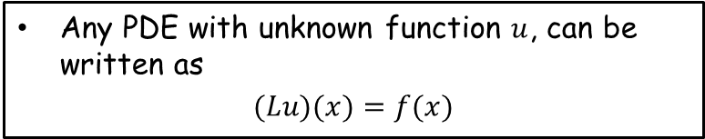
PDE in operator form
Definition
Example – Darcy flow
Any PDE with unknown function $u$, can be written as
$$(Lu)(x)=f(x)$$
Governing equation:
$$−∇⋅a\left(x\right)∇u(x)=f\left(x\right)$$
Operator (second order elliptical):
$$L≔∇⋅a ∇$$
$a(x)$ is called a parameter of the PDE.
We use subscript $L_{a}$ to denote the operator $L$ is parameterized by a
Linear PDE
A PDE is linear if and only if the operator $L$ is a linear operator.
Solution Operator
$$ψ^{†}≔L_{a}^{−1}f:a↦u$$
Nonlinear!

Slide 16
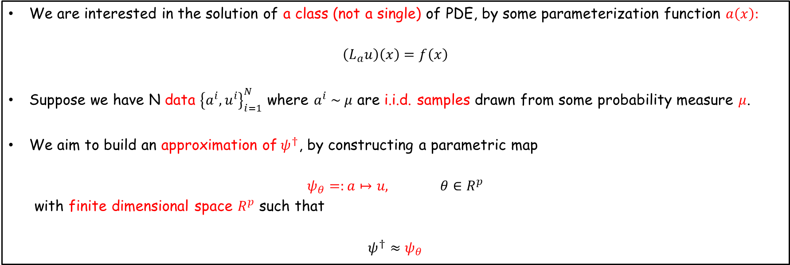
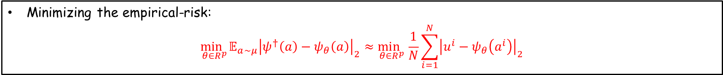
Learning the solution operator
Problem set up
We are interested in the solution of a class (not a single) of PDE, by some parameterization function $a\left(x\right):$
$$\left(L_{a}u\right)\left(x\right)=f\left(x\right)$$
Suppose we have N data ${\left\{a^{i},u^{i}\right\}}_{i=1}^{N}$ where $a^{i} \sim μ$ are i.i.d. samples drawn from some probability measure $μ$.
We aim to build an approximation of$ψ^{†}$, by constructing a parametric map
$ψ_{θ}=:a↦u,$ $θ∈R^{p}$
with finite dimensional space $R^{p}$ such that
$${ψ^{†}≈ψ}_{θ}$$
Objective
Minimizing the empirical-risk:
$$\min_{θ∈R^{p}}𝔼_{a\sim μ}{\left|ψ^{†}\left(a\right)−ψ_{θ}\left(a\right)\right|}_{2}≈\min_{θ∈R^{p}}\frac{1}{N}\sum_{i=1}^{N}{{\left|u^{i}−ψ_{θ}\left(a^{i}\right)\right|}_{2}}$$

Slide 17
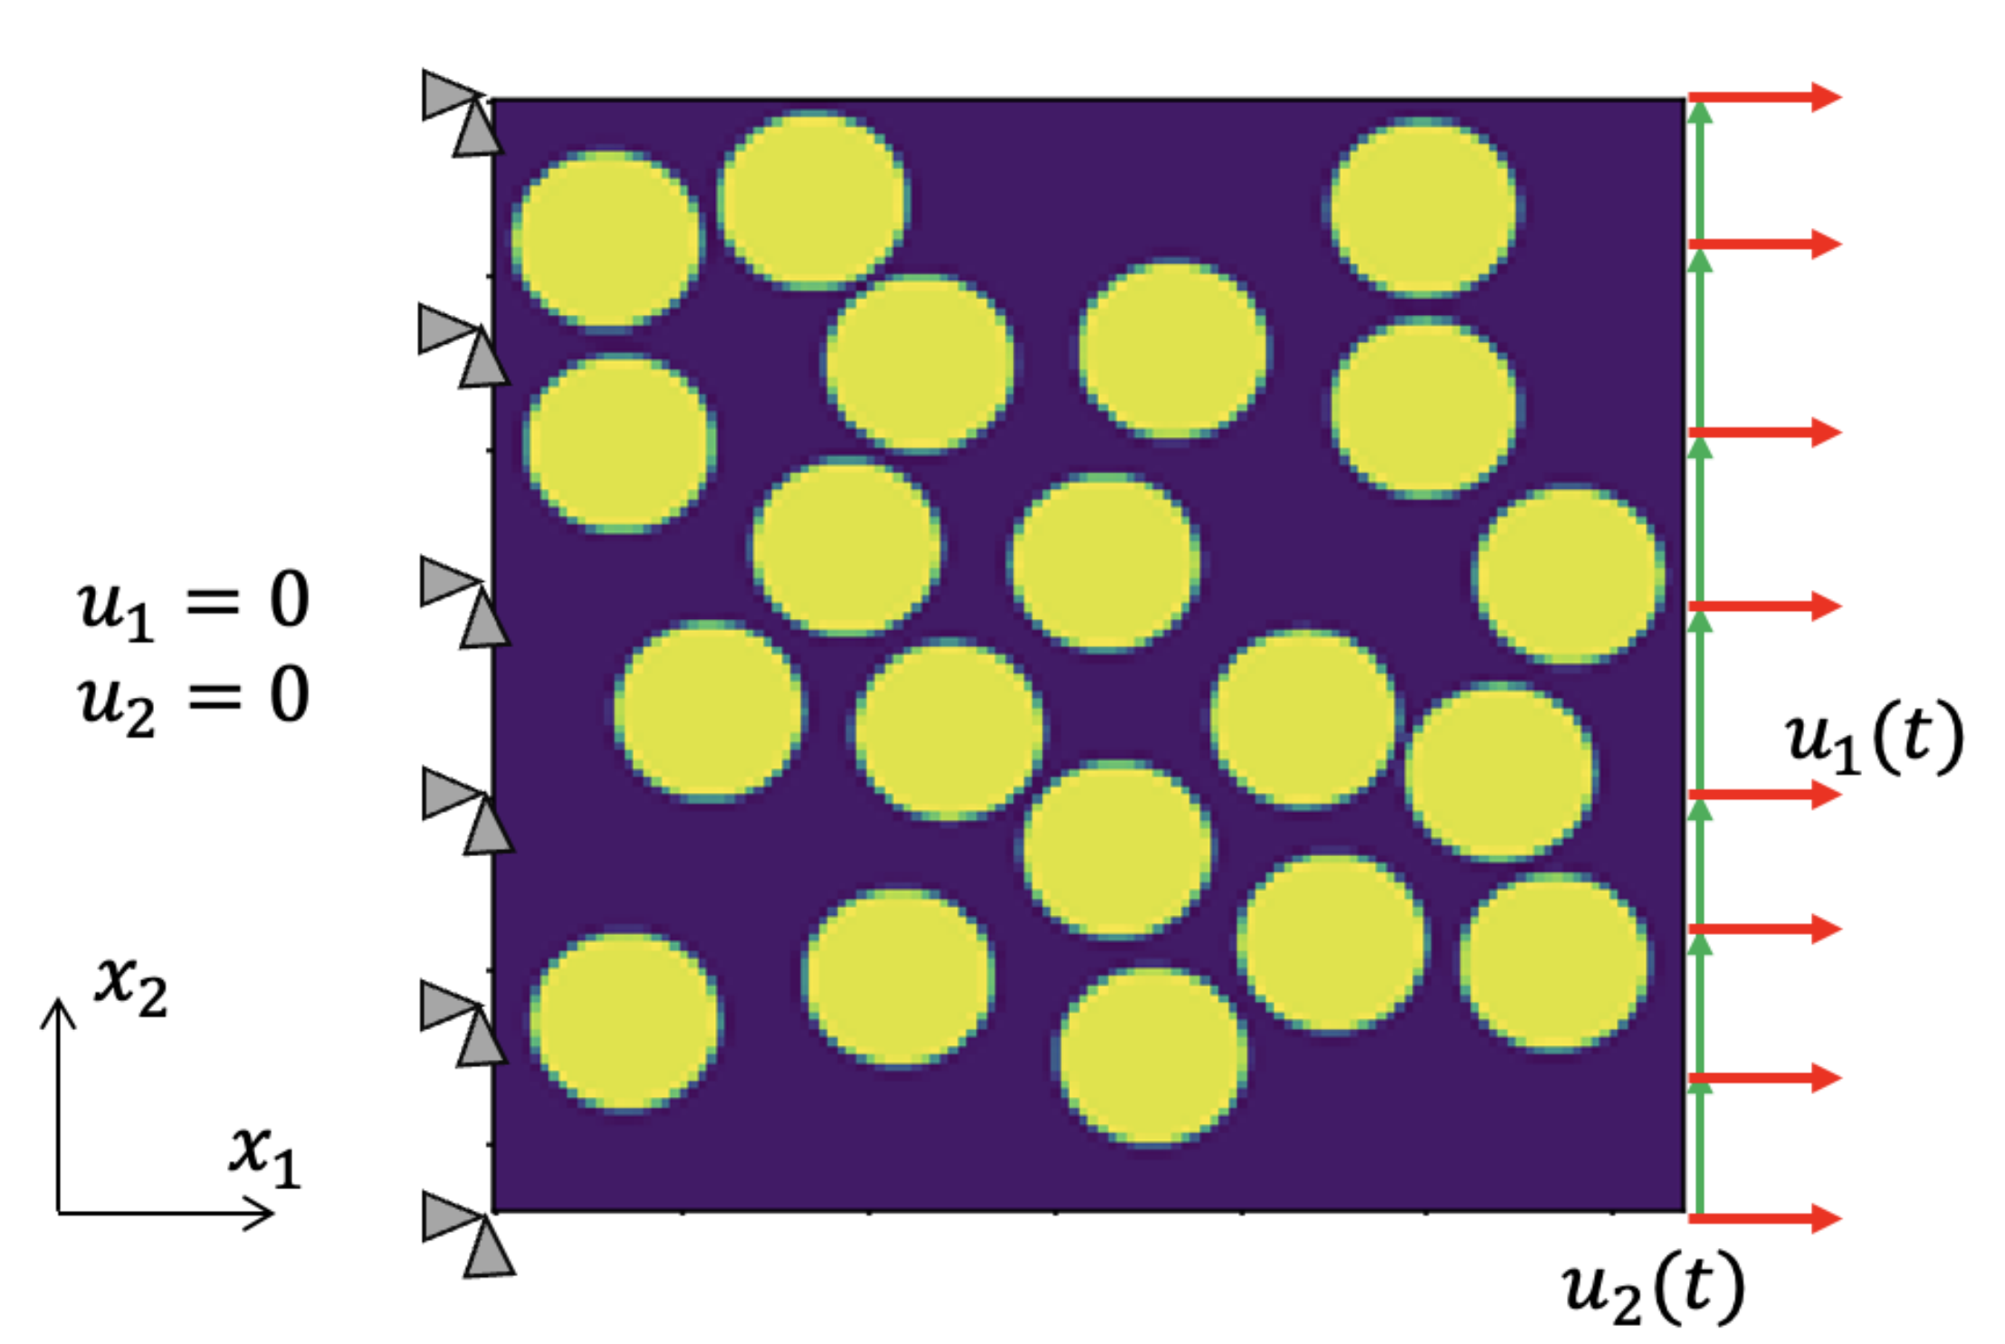
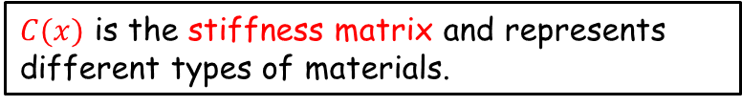
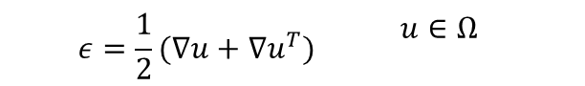
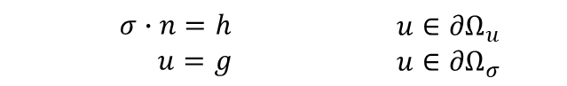
Example: Parameterized linear elasticity
Governing equations
Tension of fiber composites
(i) Balance of linear momentum:
(ii) Constitutive model (closure):
(iii) Boundary condition:
(iv) Kinematics
$∇_{x}∙σ=0$ | $u∈Ω$
$$σ=C(x)⋅ε$$ | $u∈Ω$
$$σ∙n=h$$ $$u=g$$ | $u∈{∂Ω}_{u}$ $$u∈{∂Ω}_{σ}$$
$$ε=\frac{1}{2}(∇u+∇u^{T})$$ | $u∈Ω$
Parameterization
$C(x)$ is the stiffness matrix and represents different types of materials.

Slide 18
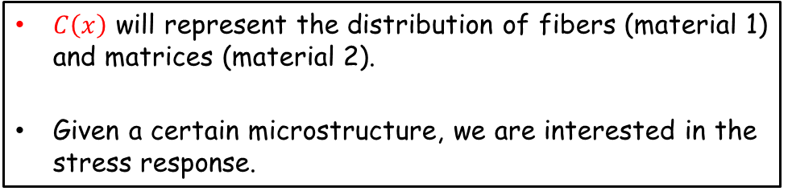
Example: Parameterized linear elasticity
Governing equations
Tension of fiber composites
(i) Balance of linear momentum:
(ii) Constitutive model (closure):
(iii) Boundary condition:
(iv) Kinematics
$∇_{x}∙σ=0$ | $u∈Ω$
$$σ=C(x)⋅ε$$ | $u∈Ω$
$$σ∙n=h$$ $$u=g$$ | $u∈{∂Ω}_{u}$ $$u∈{∂Ω}_{σ}$$
$$ε=\frac{1}{2}(∇u+∇u^{T})$$ | $u∈Ω$
$C\left(x\right)$ will represent the distribution of fibers (material 1) and matrices (material 2).
Given a certain microstructure, we are interested in the stress response.
Parameterization
$C(x)$ is the stiffness matrix and represents different types of materials.

Slide 19
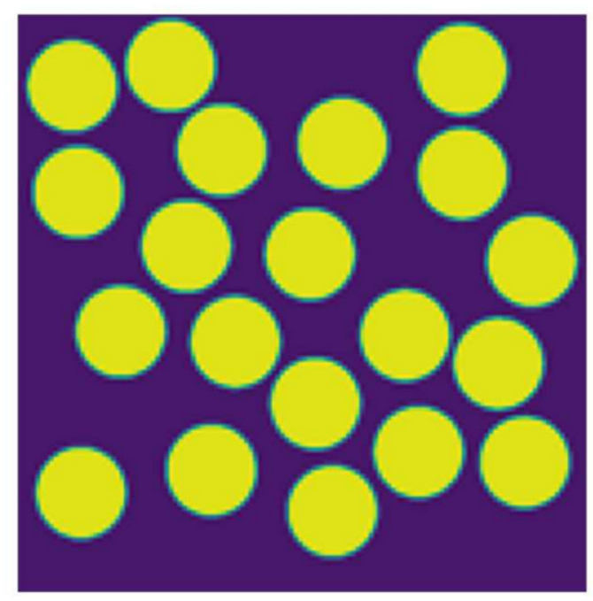
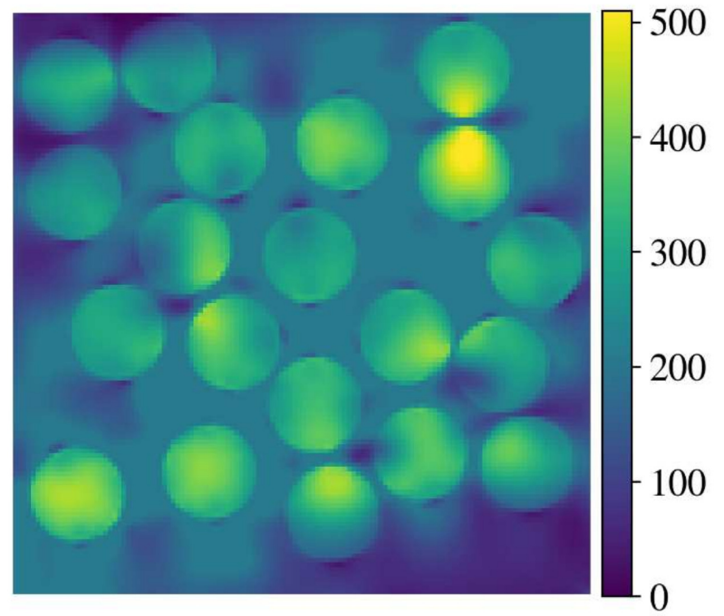

Example: Parameterized linear elasticity
Governing equations
Input c(x)
Output $σ\left(x\right)$ (Mises stress)
(i) Balance of linear momentum:
(ii) Constitutive model (closure):
(iii) Boundary condition:
(iv) Kinematics
$∇_{x}∙σ=0$ | $u∈Ω$
$$σ=C(x)⋅ε$$ | $u∈Ω$
$$σ∙n=h$$ $$u=g$$ | $u∈{∂Ω}_{u}$ $$u∈{∂Ω}_{σ}$$
Solution Operator
$$ψ^{†}≔L_{C}^{−1}f:C(x)↦σ\left(x\right)$$
$$ε=\frac{1}{2}(∇u+∇u^{T})$$ | $u∈Ω$
We seek to learn this from data !
Parameterization
$C(x)$ is the stiffness matrix and represents different types of materials.
Bhaduri, Anindya, Ashwini Gupta, and Lori Graham-Brady. "Stress field prediction in fiber-reinforced composite materials using a deep learning approach." Composites Part B: Engineering 238 (2022): 109879.

